Slide 1
Managing Transactions
Create Transactions
Commit Transactions

Slide 2

Transactions
The BEGIN TRAN statement
Name of the transaction
Transaction: executed as a single unit
The COMMIT TRAN statement

Slide 3

The ROLLBACK TRAN Statement
Cancels the previous changes
Typically executed after error checking fails

Slide 4
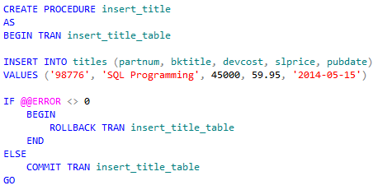
Transactions in Stored Procedures
Begins transaction
Checks to see if an error occurred
If an error occurred, rolls back transaction
If an error does not occur, commits transaction

Slide 5

The COMMIT TRAN Statement
Transaction inserts three rows
The COMMIT TRAN statement saves the changes in the transaction

Slide 6
Reflective Questions
How do you think you might implement transactions in your organization?
What benefit does using transactions offer you?

